Slide 1
PROJECT TITLE:Hiding Data Securely
CAPSTONE PROJECT
Presented By: Shivam Vats
Student Name : Shivam vats
College Name & Department : Cimage professional College

Slide 2
OUTLINE
Problem Statement
Technology used
Wow factor
End users
Result
Conclusion
Git-hub Link
Future scope

Slide 3
Problem Statement
What is Steganography?
The art of hiding data within an image.
Why is it Important?
Encryption makes data secure but also noticeable.
Steganography hides the existence of the data.
Challenges in Data Security
Secure and undetectable transmission.
Preventing data tampering.

Slide 4
Technology used
.
tkinter – GUI for user-friendly interaction.
tkinter.filedialog – File selection for images.
tkinter.messagebox – Notifications and alerts.
PIL.ImageTk – Handling image display.
os – Managing file operations.
stegano.lsb – Least Significant Bit (LSB) steganography.

Slide 5
Wow factors
Simple GUI with Tkinter – No complex CLI needed.
LSB Method – Minimal visual distortion.
Open-source & Customizable – Can be enhanced with encryption.
Usability for Various Fields – Digital watermarking, secure messaging.

Slide 6
End users
Cybersecurity Experts – Secure communication.
Government Agencies – Covert intelligence operations.
Journalists & Activists – Hiding critical messages.
Corporate & Personal Users – Encrypting sensitive information.

Slide 7
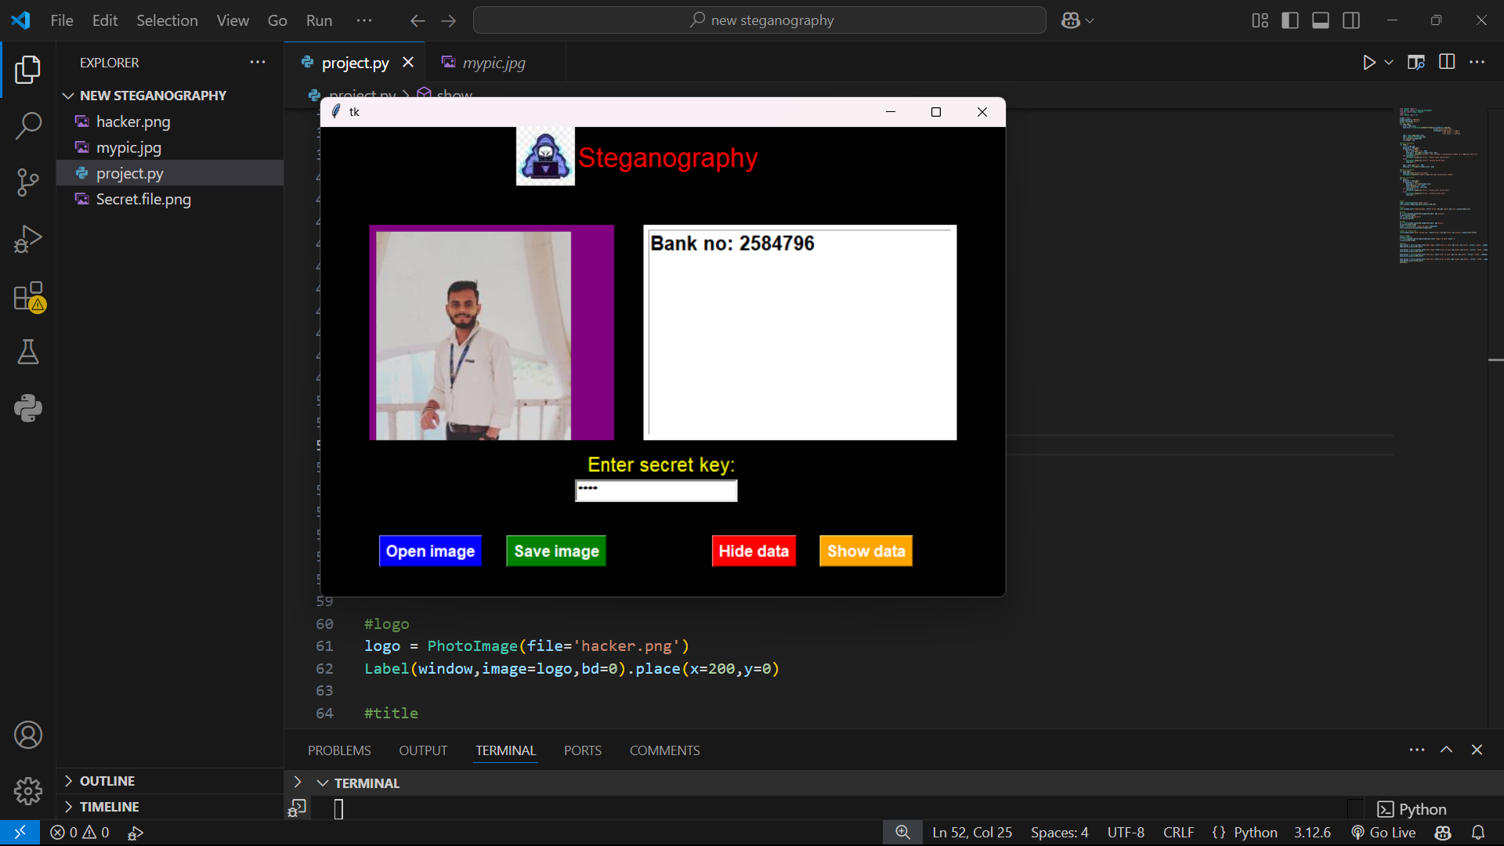
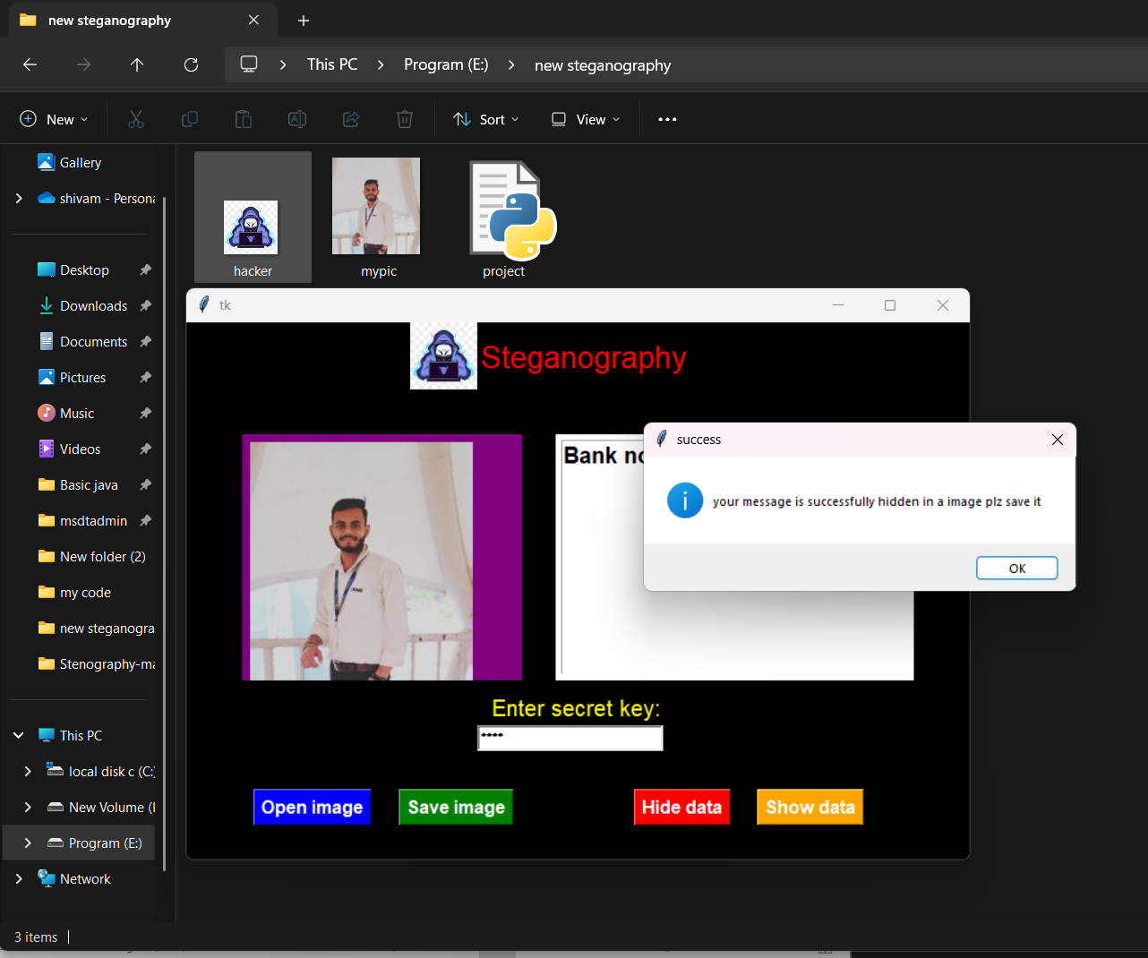
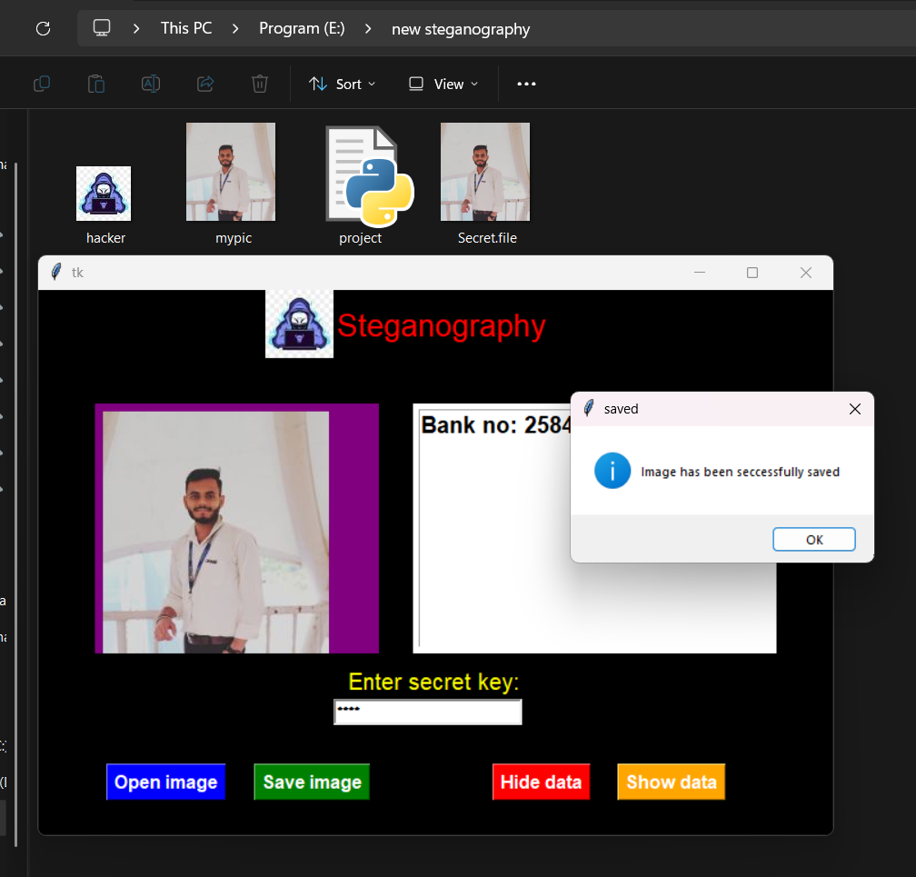
Results

Slide 8
Conclusion
Effectiveness of Steganography
Hides messages without raising suspicion.
Protects sensitive data from unauthorized access.
Easy to implement using Python libraries.

Slide 9
GitHub Link
https://github.com/shivam-vats0/Stegano-project.git

Slide 10
Future scope(optional)
Future Scope
AI-enhanced detection and counter-steganography.
Quantum steganography for ultra-secure data hiding.

Slide 11
THANK YOU

